Slide 1

CCPS 506
Comparative Programming Languages
Fall 2019
Lecture 7: More advanced Haskell

Slide 2
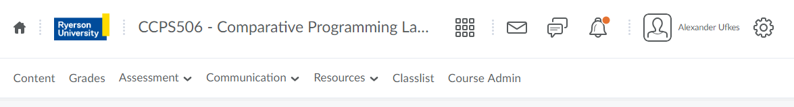
Course Administration
Assignment has been updated with Haskell specs

Slide 3

Any Questions?

Slide 4
Let’s Get Started!

Slide 5
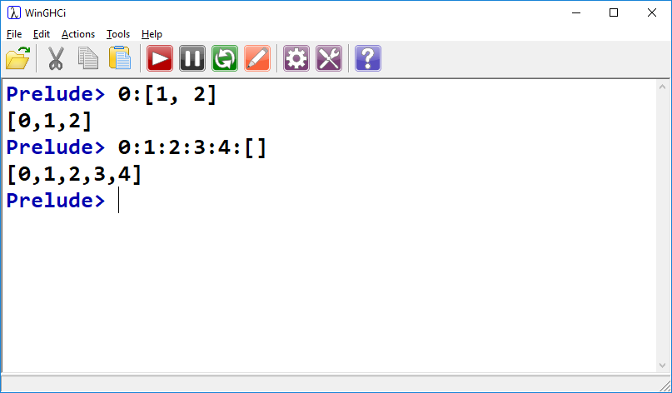
Last Week:
Lists
cons operator:
Build a list using cons operator and an empty list
In fact, when we write [1, 2, 3] the compiler is actually doing 1:2:3:[]. [1, 2, 3] notation is syntactic sugar.

Slide 6
Last Week:
List Generation
Syntactic sugar:
List declaration:
list = [1, 2, 3, 4, 5, 6, 7, 8, 9]
Can be written:
list = [1..9]
Specify interval:
list = [1,3..9]
= [1,3,5,7,9]
Interval is discerned from difference between first two elements

Slide 7
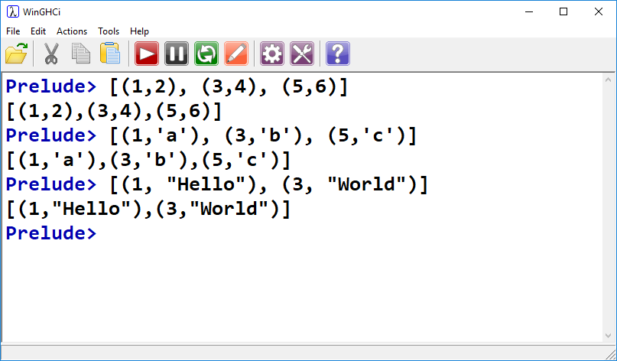
Last Week:
Lists & Tuples
Tuples can be heterogeneous, lists must be homogeneous.
However! We can have lists of tuples, where each tuple is heterogeneous.

Slide 8
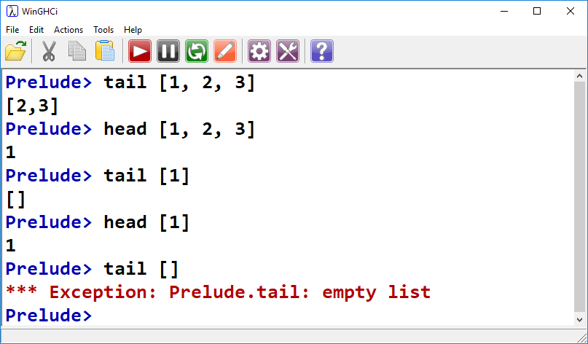
Last Week:
head & tail
Same as Elixir:
Head returns the first element
Tail returns the rest, as a list
Note boundary cases:
Single element lists
Empty lists

Slide 9
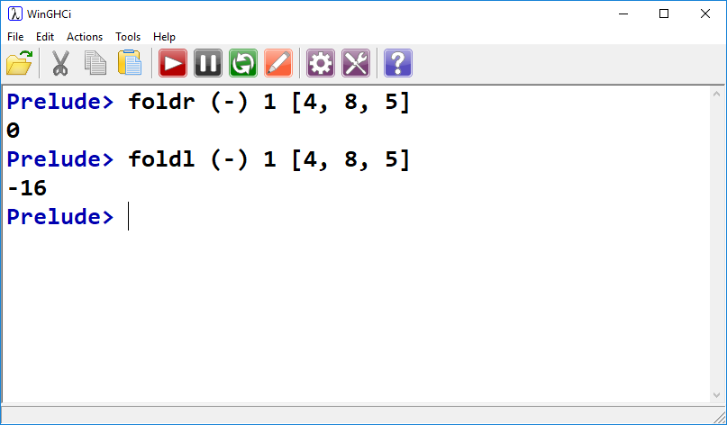
Last Week:
foldr VS. foldl

Slide 10
Moving on!

Slide 11
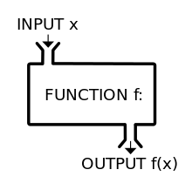

Slide 12
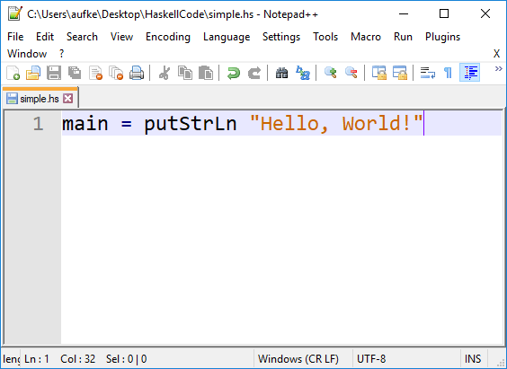
Functions in Haskell
As expected of a pure functional language, functions are central in Haskell
If we’re compiling our code, we need a main.
If we’re using the interactive window, we don’t.

Slide 13
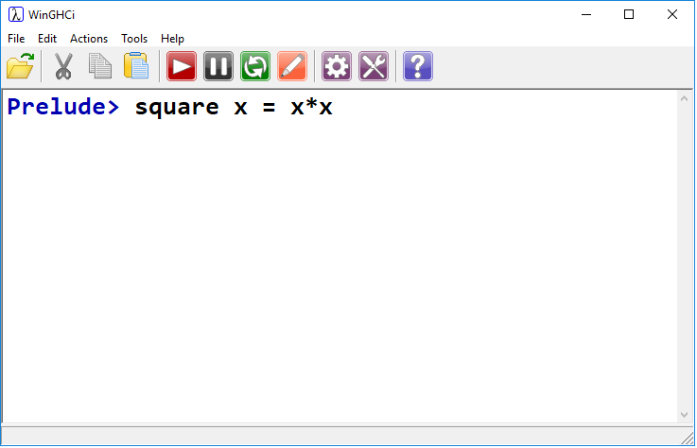
Functions in Haskell
Let’s start simple:
Define function called square that takes one argument x
square computes x*x, where x is the input argument

Slide 14
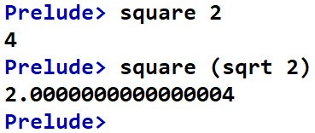
Functions in Haskell
Let’s start simple:
Invoke function square in the typical fashion

Slide 15
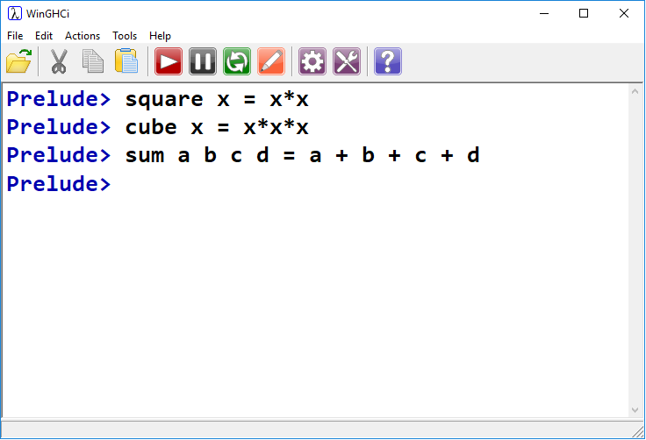
Functions in Haskell
Function named sum
Parameter list
Expression to evaluate

Slide 16
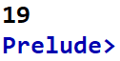
Functions in Haskell
Passing in four args

Slide 17
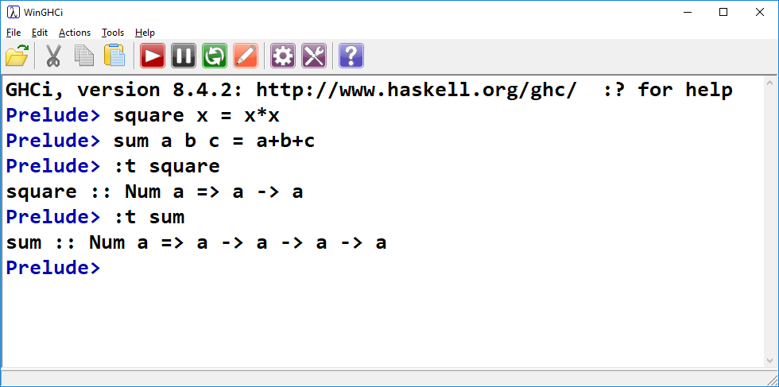
Functions in Haskell
Based on what we’re doing in square and sum (multiplying and adding)
Haskell determined that the inputs and outputs should be type Num.
+ and * are both defined for all types in typeclass Num.

Slide 18
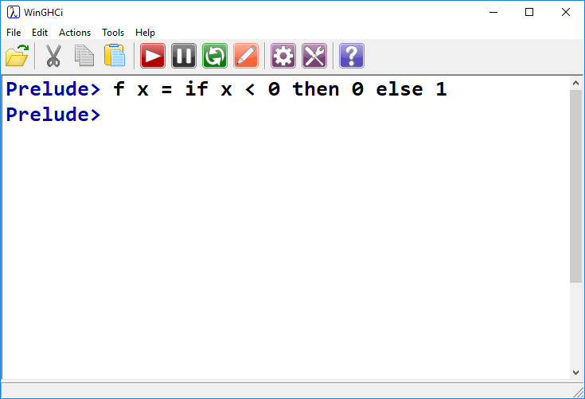
Control Structures
if then else
Function named f
Takes one arg, named x
Returns 0 if less than 0, 1 otherwise

Slide 19
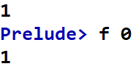
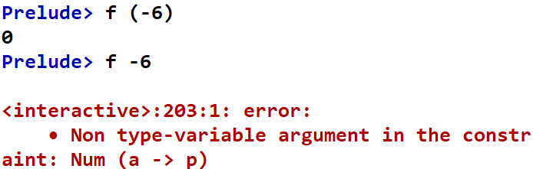
Control Structures
if then else
Brackets required around negative arguments
Otherwise it thinks you’re subtracting 6 from f

Slide 20
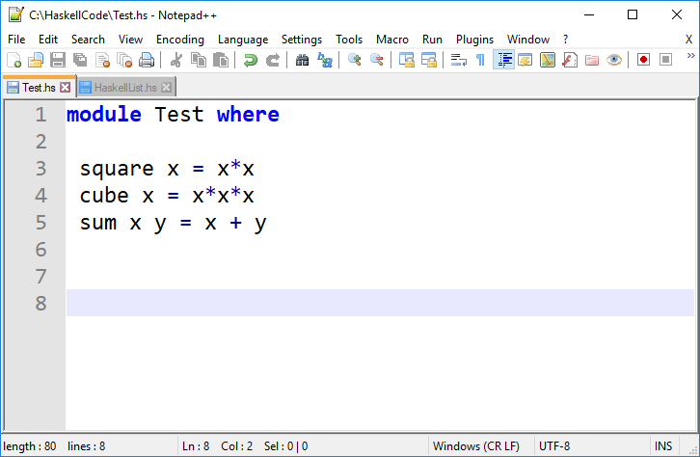
Haskell Modules
This is getting tedious to type interactively.
Let’s create a module!
Similar to modules in Elixir
We can load the module in GHCi
Access its functions and expressions

Slide 21
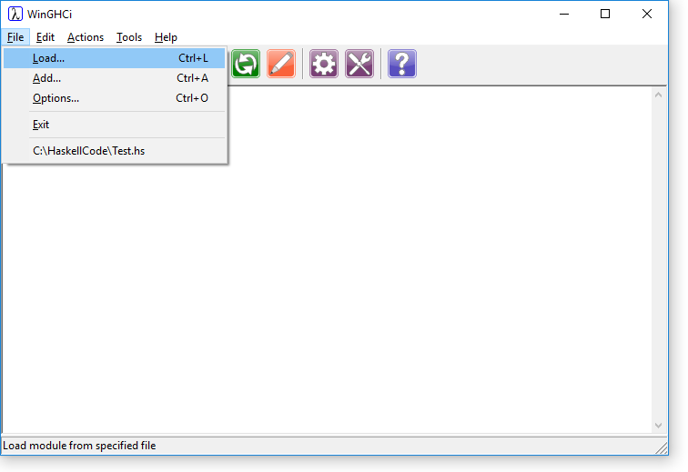
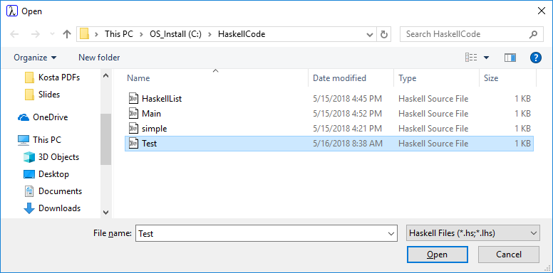
Loading a Module

Slide 22
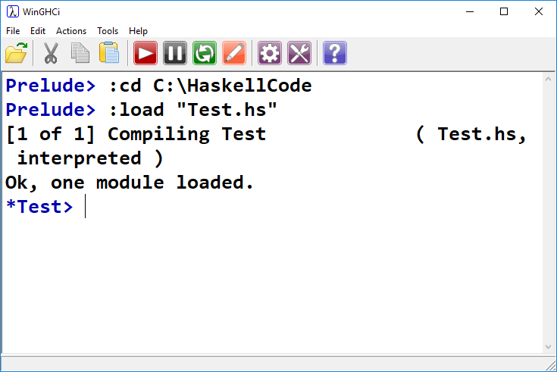

Slide 23

When we make changes to Test module, can reload with 1 click!

Slide 24
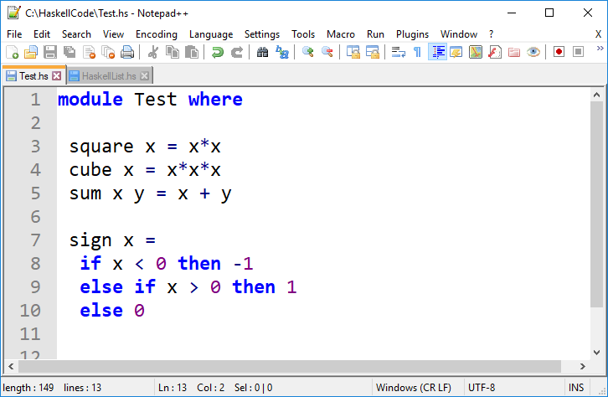
Control Structures
if then else if then else
We can now format across multiple lines.
HOWEVER: Indentation matters in Haskell!

Slide 25
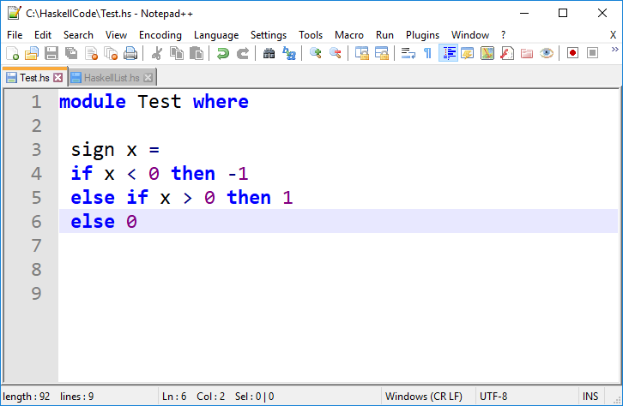
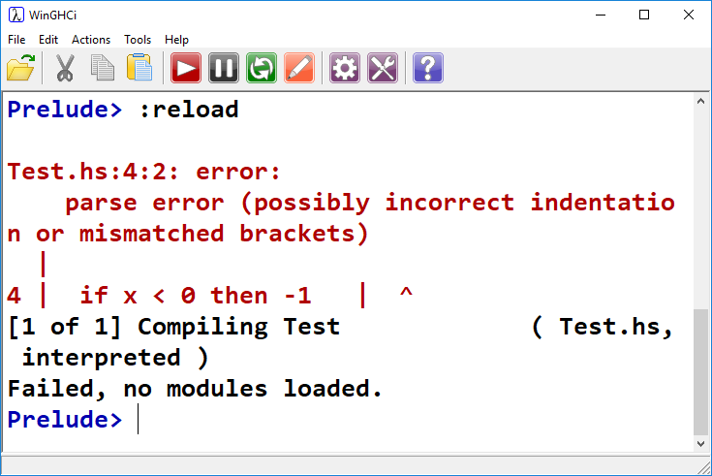

Slide 26
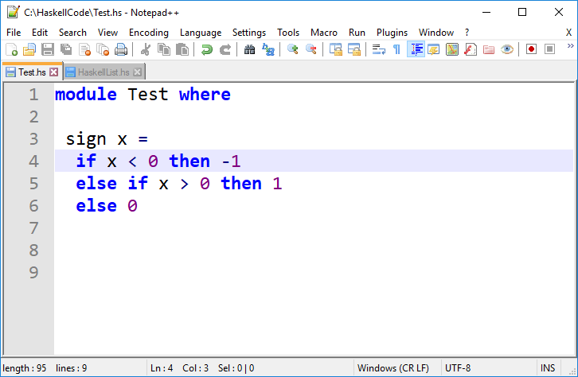
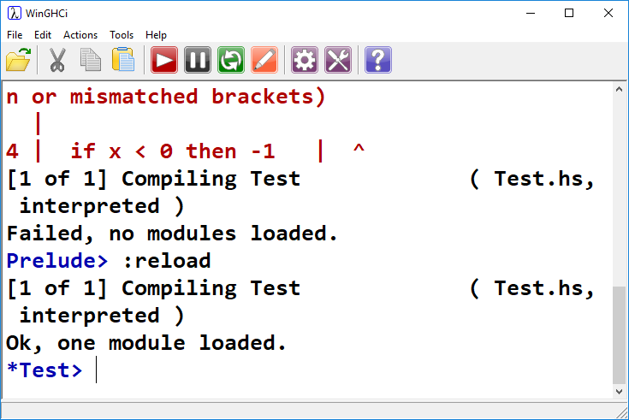

Slide 27
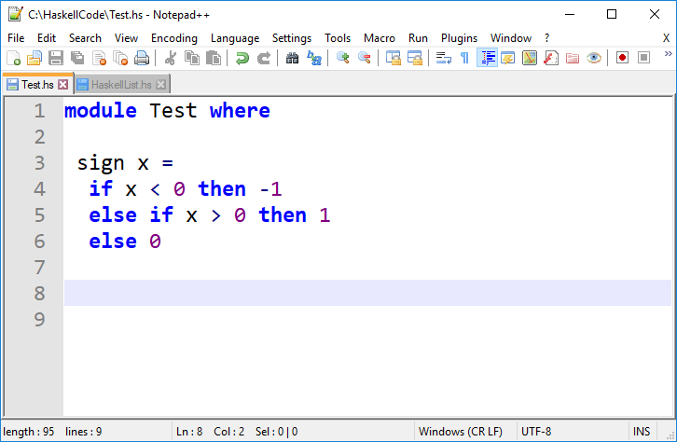
Indenting in Haskell
sign x = … is an expression. If/else must be to the right of it
Golden Rule:
Code which is part of some expression should be indented further than the beginning of that expression
https://en.wikibooks.org/wiki/Haskell/Indentation

Slide 28
If all that weren’t enough, Tabs don’t work properly unless they’re 8 spaces exactly.

Slide 29
Back to Functions
Here we have a function named sign, that takes one argument x
It returns:
-1 if x is negative
1 if x is positive
0 if x is 0
If/else construct in Haskell is similar to most other languages.
It must include a then and an else

Slide 32
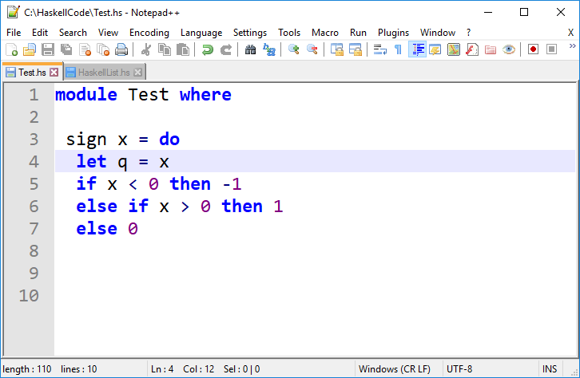
Local Names in Functions
When binding a name inside a function or module, we use the “let” keyword
This creates a local variable

Slide 33
Multiple Expressions
We now have two expressions in this function!
if/else and let
Must add the do keyword

Slide 34
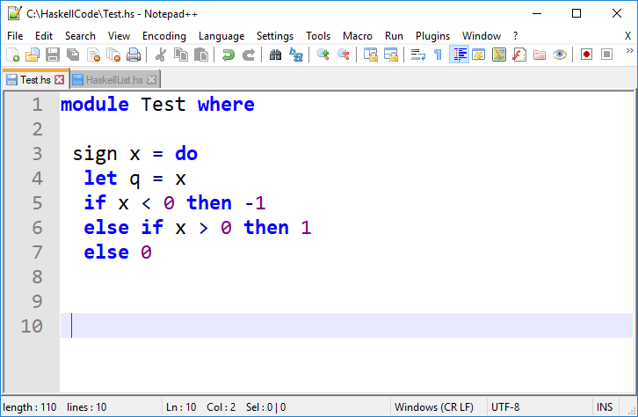
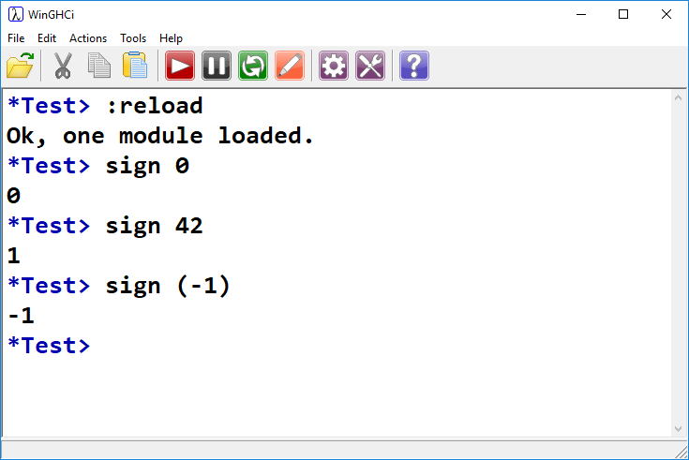


Slide 35
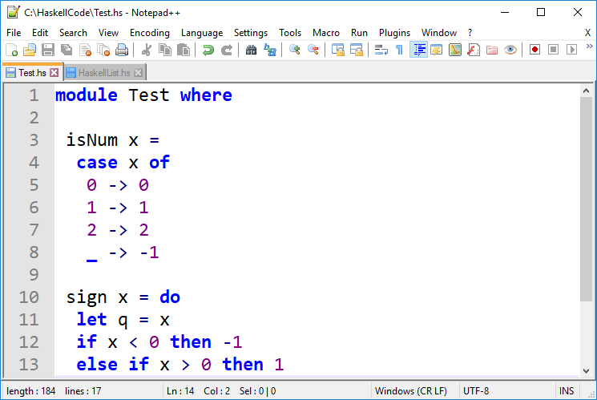
Case Statement
When matching specific values, a case construct is easier to write.
Just like Elixir, the _ is wild. It catches everything else.

Slide 36
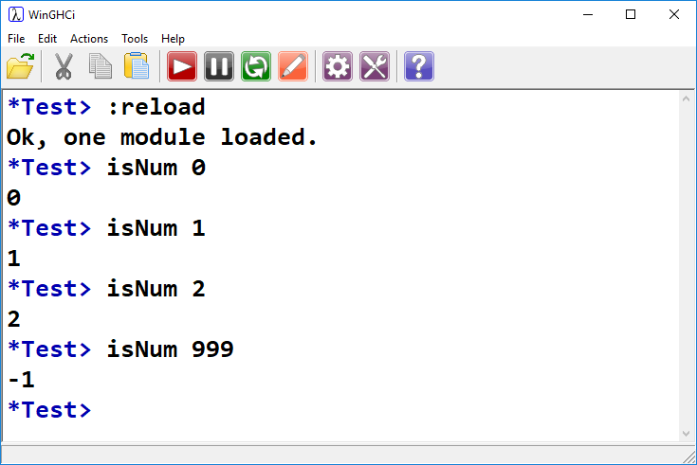
Case Statement

Slide 37
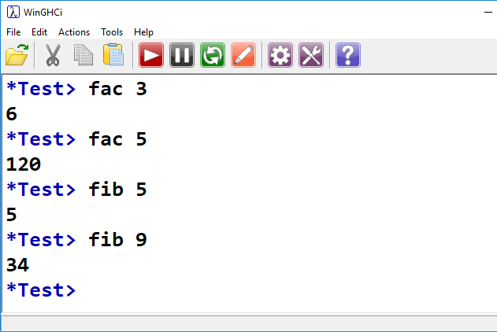
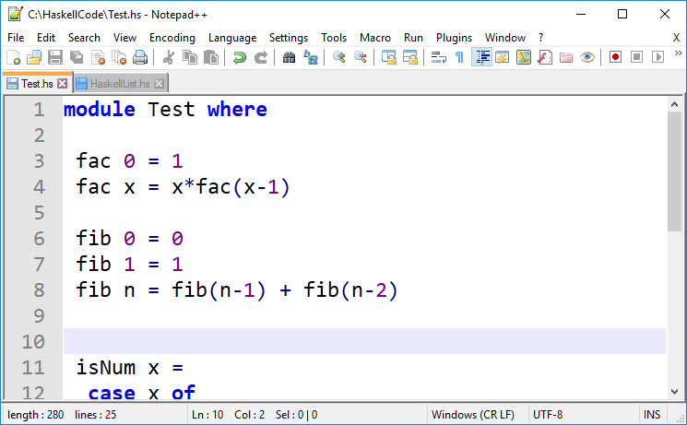
Piecewise Functions
Just like Elixir’s function signature pattern matching
Makes recursion very easy!

Slide 38
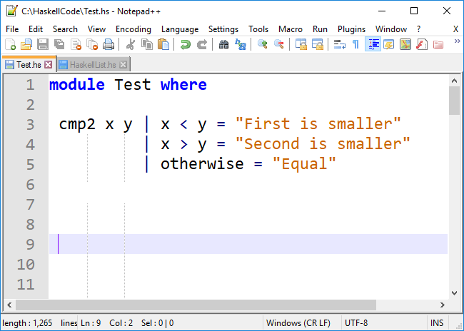
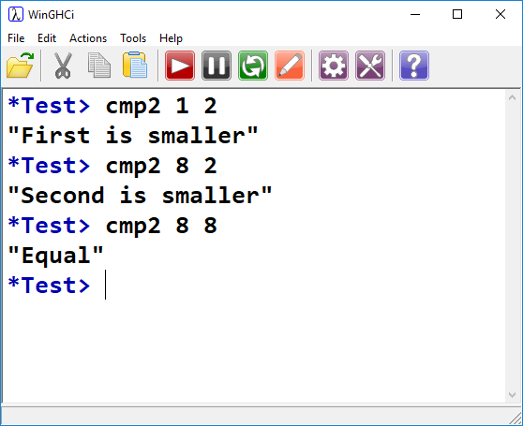
Functions: Guards
Matches input arguments to x and y
Guards denoted with |
otherwise is the same as saying True

Slide 39
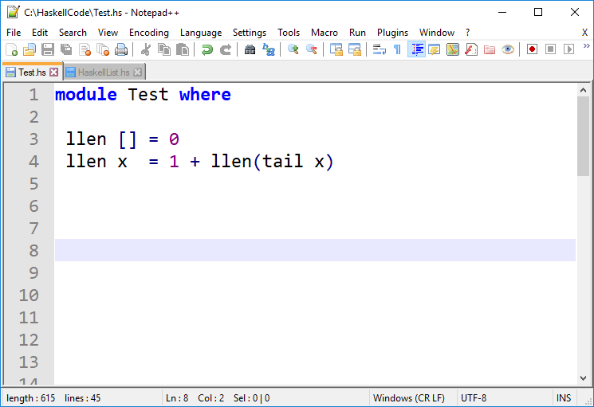
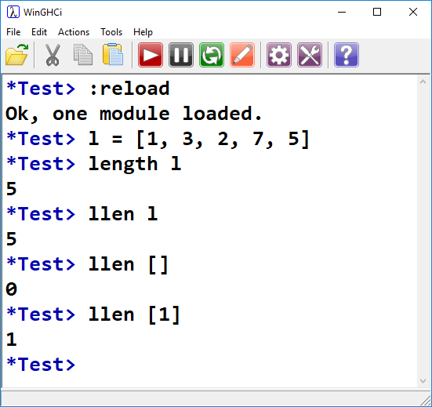
Recursion
Built-in length function
Classic list length finder
Our own user function

Slide 40
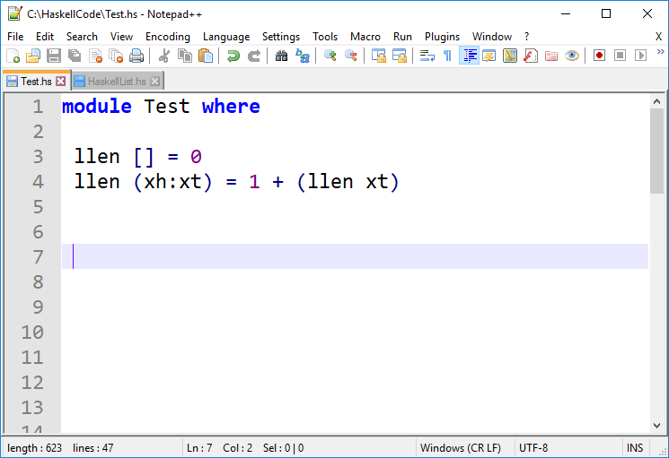
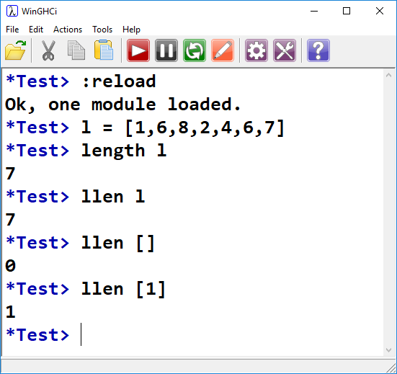
Recursion: cons
Here we treat the input argument as a pair containing the head and tail of the list.

Slide 41
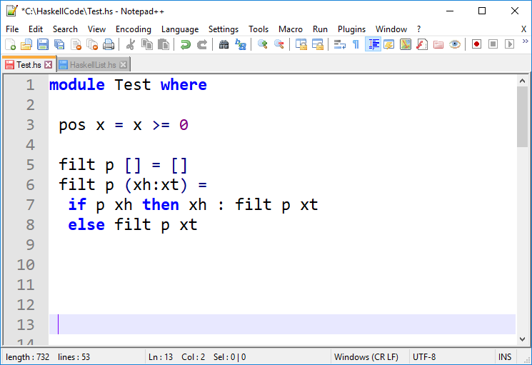
Recursion: filter
pos is first class!
filt is higher order!
Returns true if x >= 0
False otherwise
First input, p, will be a Boolean function
Second input is a list
Base case is if the list is empty
Otherwise, we call the function p with the head of the list.
If true, append it to the running list
If false, do not append
In both cases, make the recursive call with the tail.

Slide 42
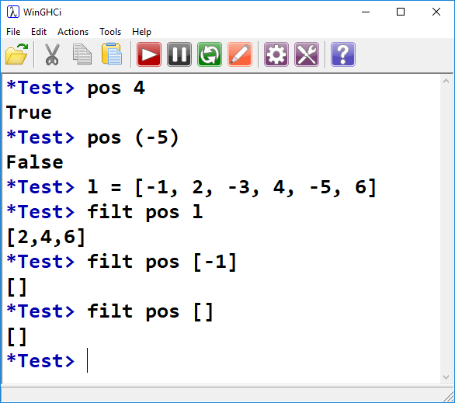
Recursion: filter
pos is first class!
filt is higher order!
Test pos function

Slide 43
Tail Recursion?
Less important in Haskell
In Haskell, function call model is different
Function calls don’t necessarily create a new stack frame
In practice, tail recursion not usually a big deal.

Slide 44
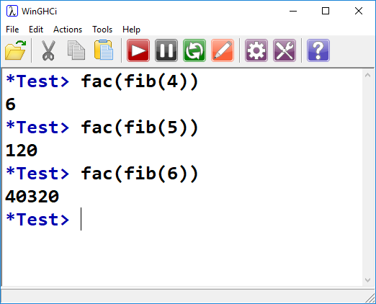
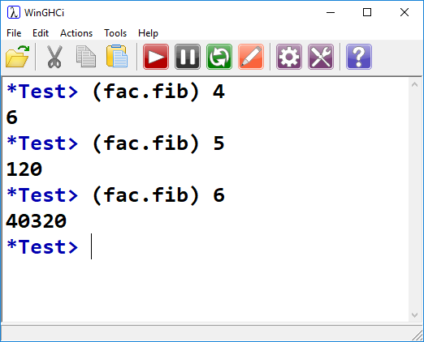
Function Composition
Can be written as:
In math, f ○ g means “f following g”. Same thing in Haskell.

Slide 45
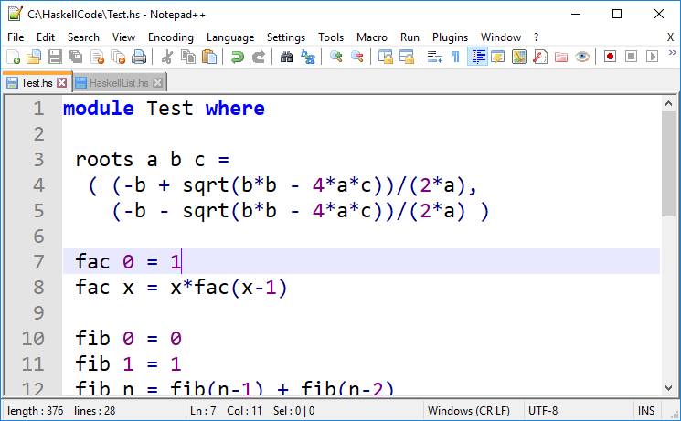
Return Multiple Things?
Lists/tuples to the rescue!
Notice there is a lot of duplicate computation here.
Add a local variable?

Slide 46
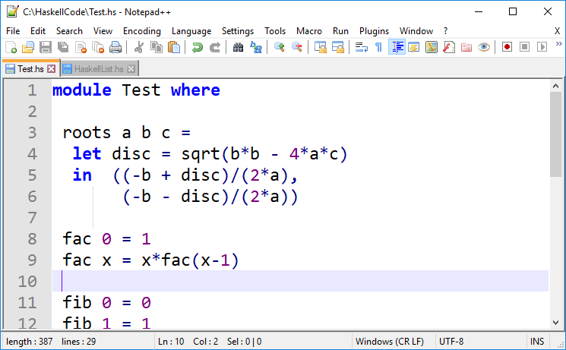
let/in Structure
This is one expression (let/in)
We don’t need to add do keyword

Slide 47
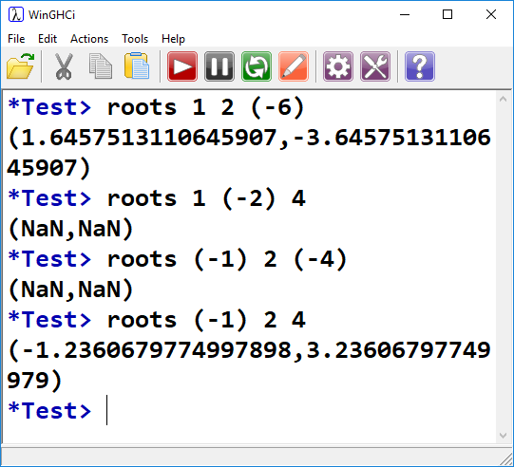

Slide 48
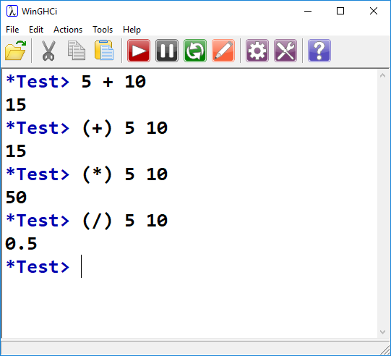
Infix Functions
Use symbolic operators as functions:
Enclose in parentheses to use in non-infix mode

Slide 49
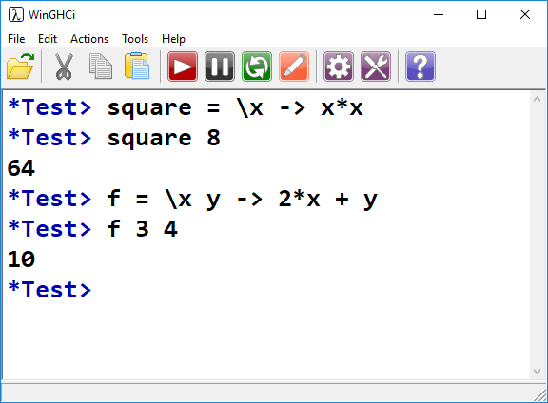
Lambda Functions
Similar to anonymous functions in Elixir:
Square as Lambda function
Lambda function with two args

Slide 50
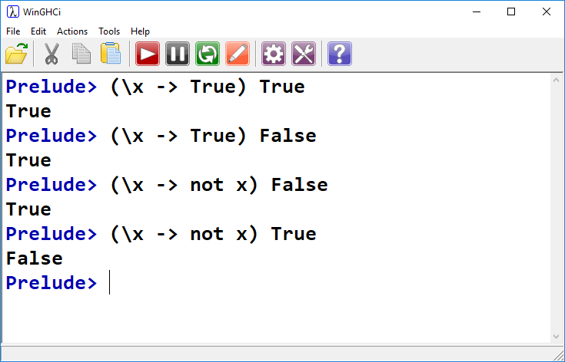
Lambda Functions
They don’t need names!
Return True no matter what
Return opposite of input
Good for passing as arguments when that’s the only place you need them!

Slide 51
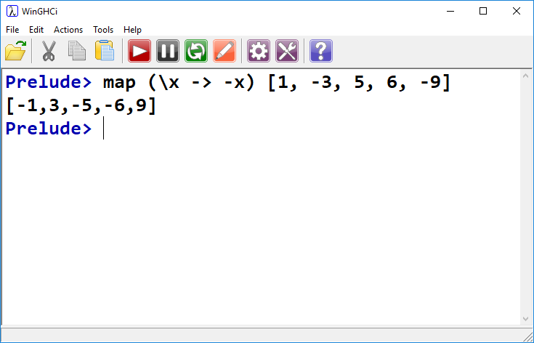
Good for passing as arguments when that’s the only place you need them!
Use with map, flip sign of list elements

Slide 52
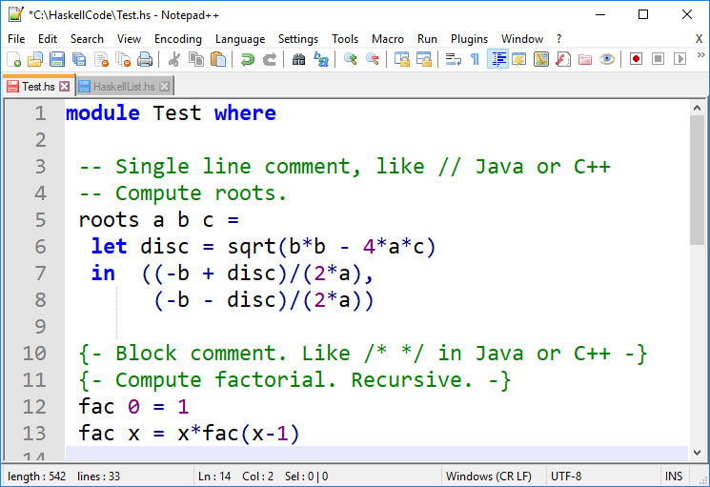
Comments
About time we mentioned them…

Slide 53

Pattern Matching

Slide 54


Pattern Matching: Function Signatures
Return unit vector if point lies on axis
Return input point otherwise

Slide 55


Pattern Matching: Case
Most commonly used with case expressions

Slide 56


Pattern Matching: Case
Will never match!

Slide 57



Slide 58


Unlike Elixir…
Try and be more general to catch anything that isn’t a 3-tuple?

Slide 59

?

Slide 60
Revisiting Types
Type polymorphism and type variables:
Recall: Overloading
In languages like Java, the == operator is overloaded to work with many different types.
Numeric type equality and object equality are performed differently.
In general, if we want to compare two values of type α, we use an α-compare
α is a type variable, because its value is a type.

Slide 61
Type Classes
Consider the equality (==) operator:
Takes two parameters, each of the same type (call it α), and returns a Boolean
This operator may not be defined for all types, just some.
Thus, we can associate == with a specific type class containing those types for which == is defined.
This type class is called Eq in Haskell.

Slide 62

Eq Type Class
(==) is defined for types in typeclass Eq
(==) takes two args of type a, where a is a member of type class Eq
It returns Bool
If a concrete type, α, belongs to a certain type class, we say α is an instance of that type class.
Int is an instance of Eq, for example.

Slide 63

Num Type Class
This allows numeric values freedom to be an integer or floating point as the compiler sees fit.
Num class contains all numbers, and certain operations over them such as addition.

Slide 64
Num Type Class
p is a type variable
The type of 5 is p, and p is a member of type class Num

Slide 65


Show Type Class
Types that are members of the Show class have functions which convert their value to a String.

Slide 66

Function Types
head takes a list containing type a, and returns a value of type a
tail takes a list containing type a, and returns a list containing type a
a and b can be literally any type!

Slide 67
Type of chkClr is inferred:
Takes as input a tuple with three values
(a1, a2, a3)
The type of each value in the tuple must be instances of type class Eq and Num.
The output of chkClr is a character list.

Slide 68
Type Inference
Based on the contents of chkClr:
Haskell determined that the output is [Char]
The input is a 3-tuple whose elements must be instances of Num and Eq.

Slide 69

Elixir is dynamically typed
Types are checked at run-time
This allows us to use cases and guards to check type
Haskell is statically typed
Types are determined/checked at compile-time
When we load the module containing chkClr, its type is inferred
We can’t call chkClr with types that don’t match

Slide 70
We’ll create our own types soon, and see how to add them to existing type classes.

Slide 71


Define Function Type
chkAxis takes a pair-tuple of Floats as input, and returns the same as output.
Instead of constants being of type Num or Fractional, they are treated as Floats

Slide 72

Define Function Type

Slide 73


Thoughts?

Slide 74




?
Ord is a type class:
When we didn’t explicitly define our types, Haskell inferred the type for us.
Ord is a type class under which the operations used on our inputs are defined.
I.e., greater than and less than operators.

Slide 75


Type VS Type Class
Ord is a type class, thus we specify that a is an instance of Ord
cmp2 accepts two instances of Ord as arguments.
Ord contains many different types, a can be any of them
Int & Char are types, not type classes
We can use the above notation

Slide 76

Ord Type Class
Ord is a type class that supports comparison
Comparison is all we’re doing in our function
Thus, Haskell infers types as Ord

Slide 77

Ord Type Class
Int is an instance of Ord type class, so when we made our function args explicitly Int, we were OK

Slide 78


How About This?

Slide 79

Num type class does not define comparison!

Slide 80


Hmmmm…
Num doesn’t have comparison, Ord doesn’t have addition
It compiled and loaded, what type did Haskell infer for x and y?

Slide 81

Both!
Whatever type we pass in (a), it must be an instance of both Ord and Num.
Int is one such type, as is Float

Slide 82


Ord:
Num:

Slide 83

Custom Data Types

Slide 84
Custom Data Types
Lists and tuples are already quite powerful for organizing data
What if we want to add custom behaviors over our data?
For example, we can declare a pair tuple (1, 2).
What if we want to treat these as coordinates and compute the sum? The dot product? Etc.?
Addition is not defined for tuples, let alone more complicated operations.

Slide 85
Custom Coordinate Types
Custom type name
data Pt3 a = Pt3 Float Float Float
Keyword indicating a custom type definition
Type variable(s) indicating the different types contained in our custom type
Constructor for our custom type. To construct a Pt3, we need 3 values of type Float

Slide 86



Slide 87

Custom Type Usage
This is funny – viewing a variable in the interactive window requires its type to be an instance of Show!

Slide 88

Hmmm…
The values contained in Pt3 are Float, and we know that Float is an instance of Show.
How can we access the individual elements of Pt3?

Slide 89



Three access functions, one for each of the three values.
Take as arguments Pt3 (and by extension its three members)
Return x, y, or z coordinate respectively.
Cool!

Slide 90

Overloading Constructor
Define Pt3 with three parameters
Define Pt2 with two parameters
Name of our data type is now simply Pt, because we have made it more generic.
There is now a problem with our access functions

Slide 91


There is now a problem with our access functions.
Now our access functions work for both Pt2 and Pt3

Slide 92
Deriving Show
Recall:

Slide 93


Deriving Show
Our custom type will inherit some default display behavior from Show
Similar to the toString() method in Java!

Slide 94


More Advanced Functions
Compute length of Pt2 and Pt3, treating them as vectors

Slide 95

Addition, Subtraction, Equality?
Let’s add more functions!
We can very easily define addition as the sum of each respective X and Y coord
Likewise for subtraction and equality.

Slide 96

Addition, Subtraction, Equality?

Slide 97
Addition, Subtraction, Equality?
This seems very clunky. Why can’t we simply add, subtract, or check equality with the symbolic operators (+, -, ==)?
We can! Equality is defined for instances of type class Eq
+, -, etc. are defined for instances of type class Num.
How do we make Pt2 and Pt3 instances of another type class?

Slide 98

Custom Types & Existing Type Classes
Define what it means for two Pt2 values to be considered equal
Declare Pt to be an instance of Eq

Slide 99


Slide 100

Minimal Definition
The minimal definition for being an instance of Eq is == *OR* /= (not equal)
We only defined ==

Slide 101


Haskell is clever enough to derive /= from our definition of ==, and vice versa.

Slide 102


Let’s Add /= Anyway

Slide 103

By The Way…
This should remind you of interfaces in Java
If you create a Java class that implements an interface, it must define all method signatures present in that interface
Most common is the Comparable interface
If our Java class implements Comparable, we must define some way of comparing two instances of our class

Slide 104


Instance of Num

Slide 105


We’re only implementing for Pt2.
Adding Pt3 follows the same pattern

Slide 106

Instance of Num

Slide 107

This may look circular
We’re using abs and signum in our definition of abs and signum.
However! x1 and y1 are Float.
abs and signum are defined for Float
We’re defining them for Pt2

Slide 108


fromInteger is a coercion function.
Dictates how our custom type can be created from an Integer
Takes an Integer, returns a Pt
Lets us do this…

Slide 109

No more warnings!

Slide 110


Slide 111

Instance of Show
In Java-speak, define our own toString(), instead of deriving the default
The minimal definition for Show is easy
Need to implement show OR showsPrec
Let’s do show
Need to go from Pt2 to a String

Slide 112

No longer need to derive Show, we’ve made our own
Use string concatenation to create a pleasing visual output for Pt2
In doing so, we make use of show as defined for Floats

Slide 113


Slide 114
Haskell Tutorials/References:
https://en.wikibooks.org/wiki/Yet_Another_Haskell_Tutorial
http://cheatsheet.codeslower.com/CheatSheet.pdf

Slide 115


Slide 116

Enum.reduce: We can do it!
Result initialized as head of list
Pass head of list and current result into f

Slide 117

Enum.reduce: We can do it!

Slide 118
acc is the running value
By default, initialized to first element in list
We can add an optional 3rd argument to initialize acc:
iex> Enum.reduce([1, 2, 3], 10, fn(x, acc) -> x+acc end)
16
iex> Enum.reduce([1, 2, 3], fn(x, acc) -> x+acc end)
6
10 + 1 + 2 + 3
VS
1 + 2 + 3

Slide 119
MyEnum.reduce/3 Solution
Use private functions with different names to avoid ambiguity in recursive calls
def reduce(list, f) do reduceP((tl list), f, hd list) end
def reduce(list, acc, f) do reduceP(list, f, acc) end
defp reduceP([], _, res) do res end
defp reduceP([h|t], f, res) do reduceP(t, f, f.(h, res)) end

